Slide 1
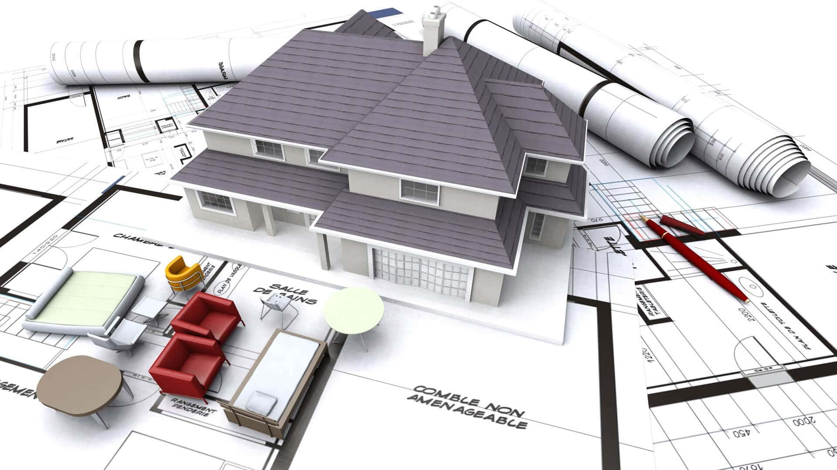

MEASURING INSTRUMENTS
MECHANICAL DRAFTING

Slide 2
REVIEW
Fill in the blanks

Slide 3
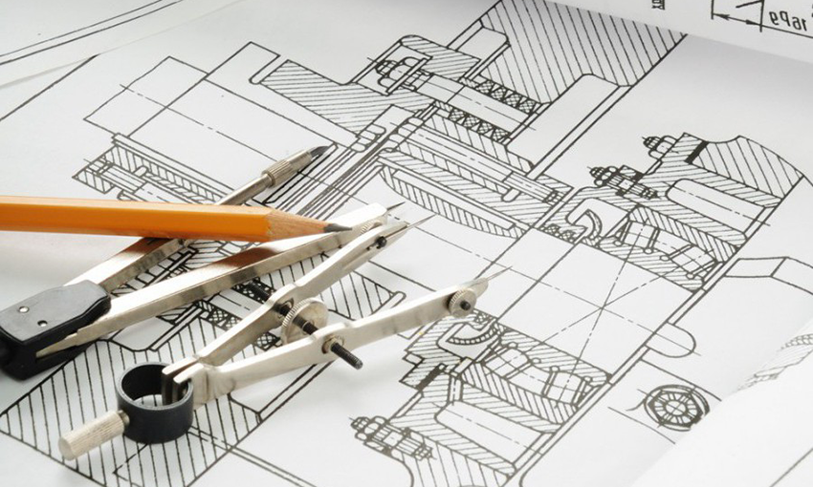

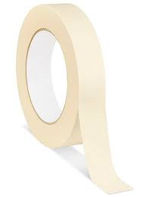
Fill the following words using some given letters and the pictures for each corresponding items.
­_ R _ _ I _ G
_ A _ E _
­D R A W I N G
P A P E R
M A S K I N G
T A P E
_ _ S _ I N G
_ A P _

Slide 4
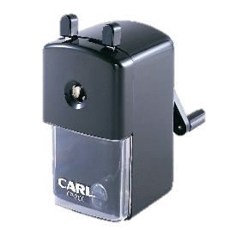
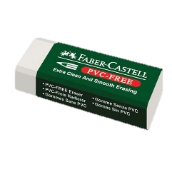
Fill the following words using some given letters and the pictures for each corresponding items.
P E N C I L
S H A R P E N E R
_ E N _ I L
S _ A R _ _ N E R
E R A S E R
_ R A _ E _

Slide 5
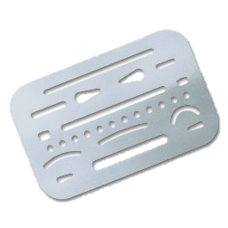
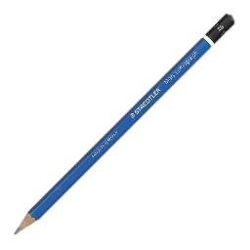
Fill the following words using some given letters and the pictures for each corresponding items.
P E N C I L
_ E _ C I _
E _ _ S _ N G
S _ I E _ D
E R A S I N G
S H I E L D

Slide 6
MOTIVATION
FILM SHOWING

Slide 7
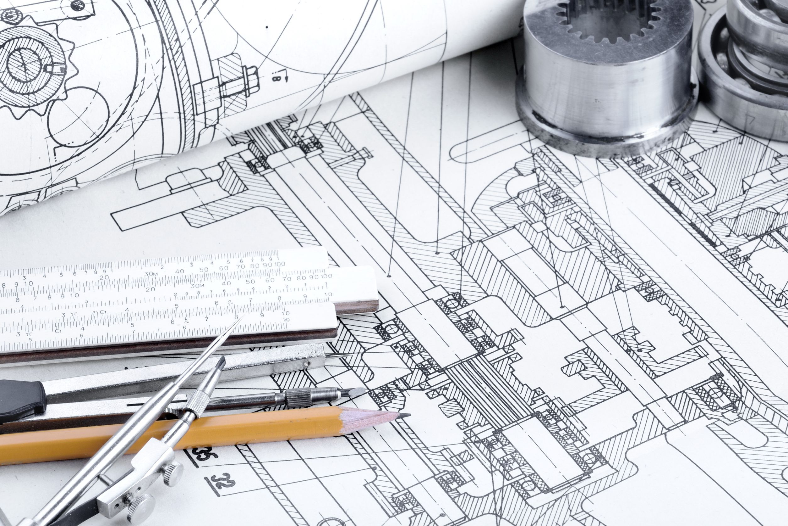
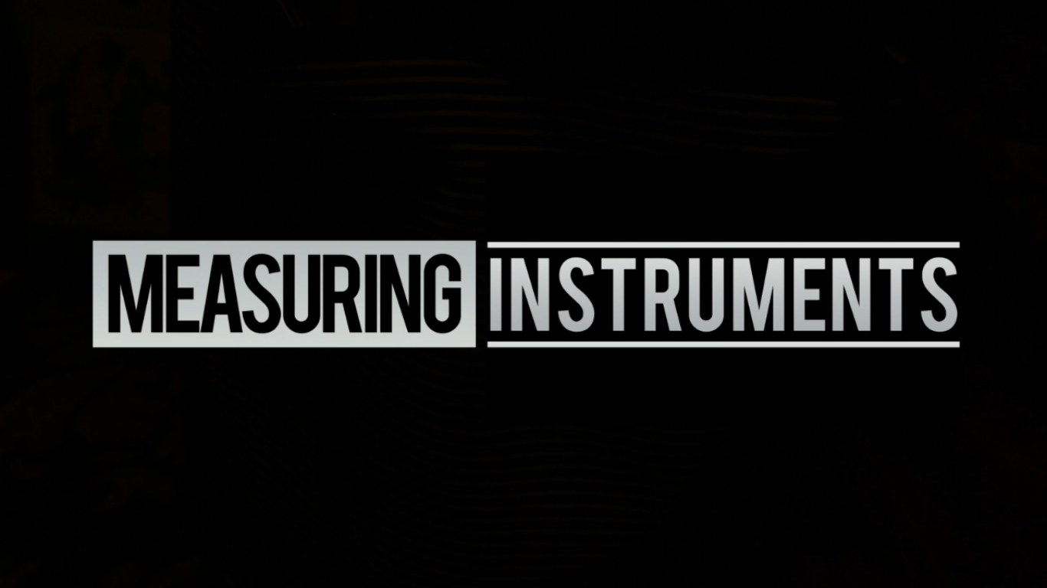
“AVENGERS
(Earth’s Mightiest Heroes)”

Slide 8
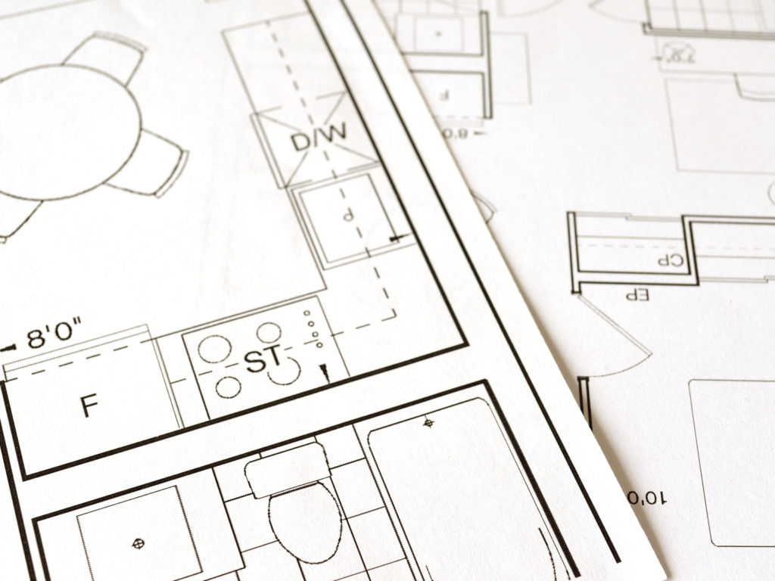
TECHNICAL TERMS
Measuring – the size, amount, or degree of (something) by using an instrument or device marked in standard units or by comparing it with an object of known size.
Angle – the space (usually measured in degrees) between two intersecting lines or surfaces at or close to the point where they meet.
Horizontal – parallel to the plane of the horizon; at right angles to the vertical.
Dimension – a measurable extent of some kind, such as length, breadth, depth, or height
Vertex – the highest point

Slide 9
MEASURING INSTRUMENTS
MECHANICAL DRAFTING

Slide 10
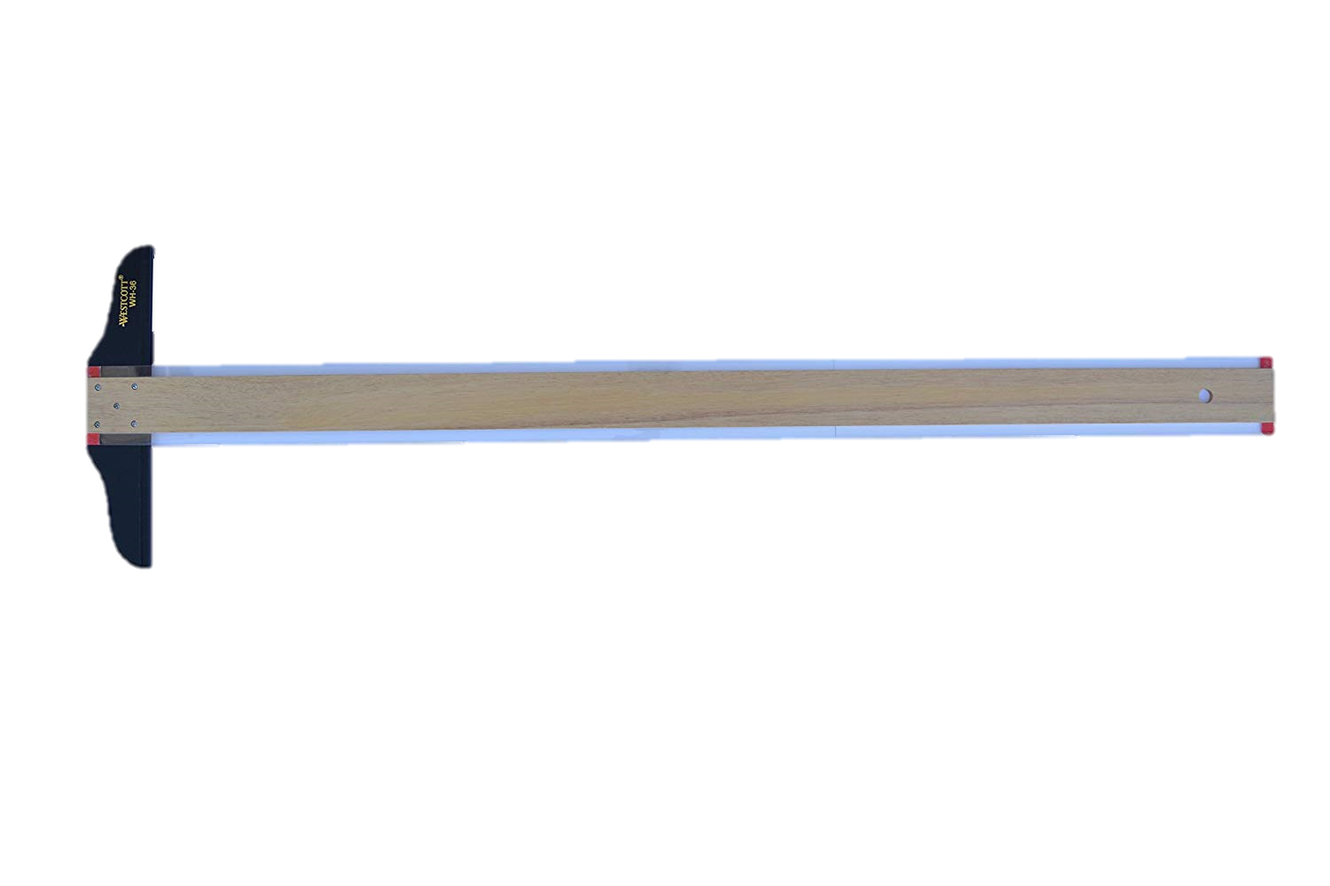
T - SQUARE
is used as guide in drawing horizontal lines and in measuring up to 48” straight line.

Slide 11
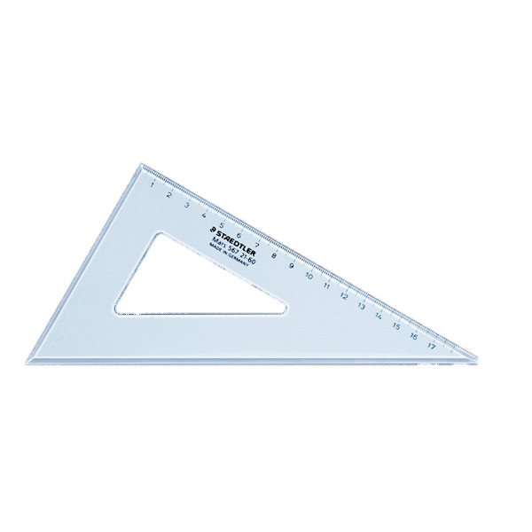
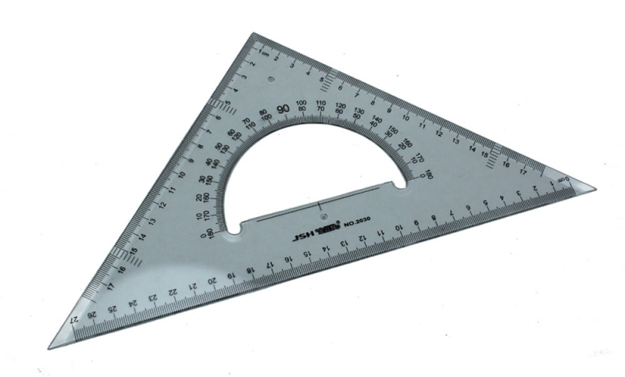
TRIANGLES
are used for drawing vertical and oblique lines. The most commonly used triangles are the 45° and the 30°x 60°.
30°x 60°
45°

Slide 12
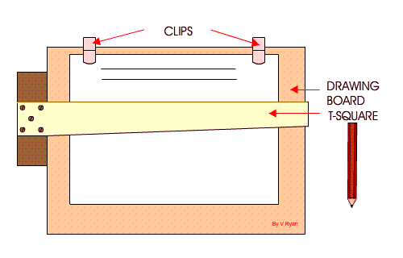
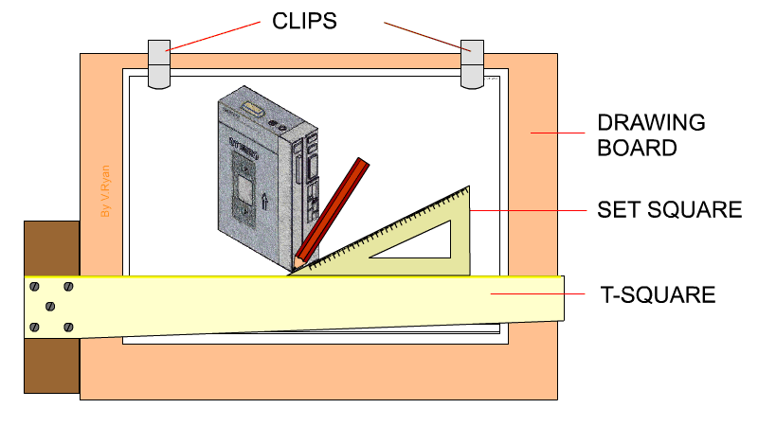
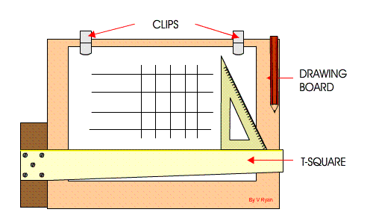

Slide 13
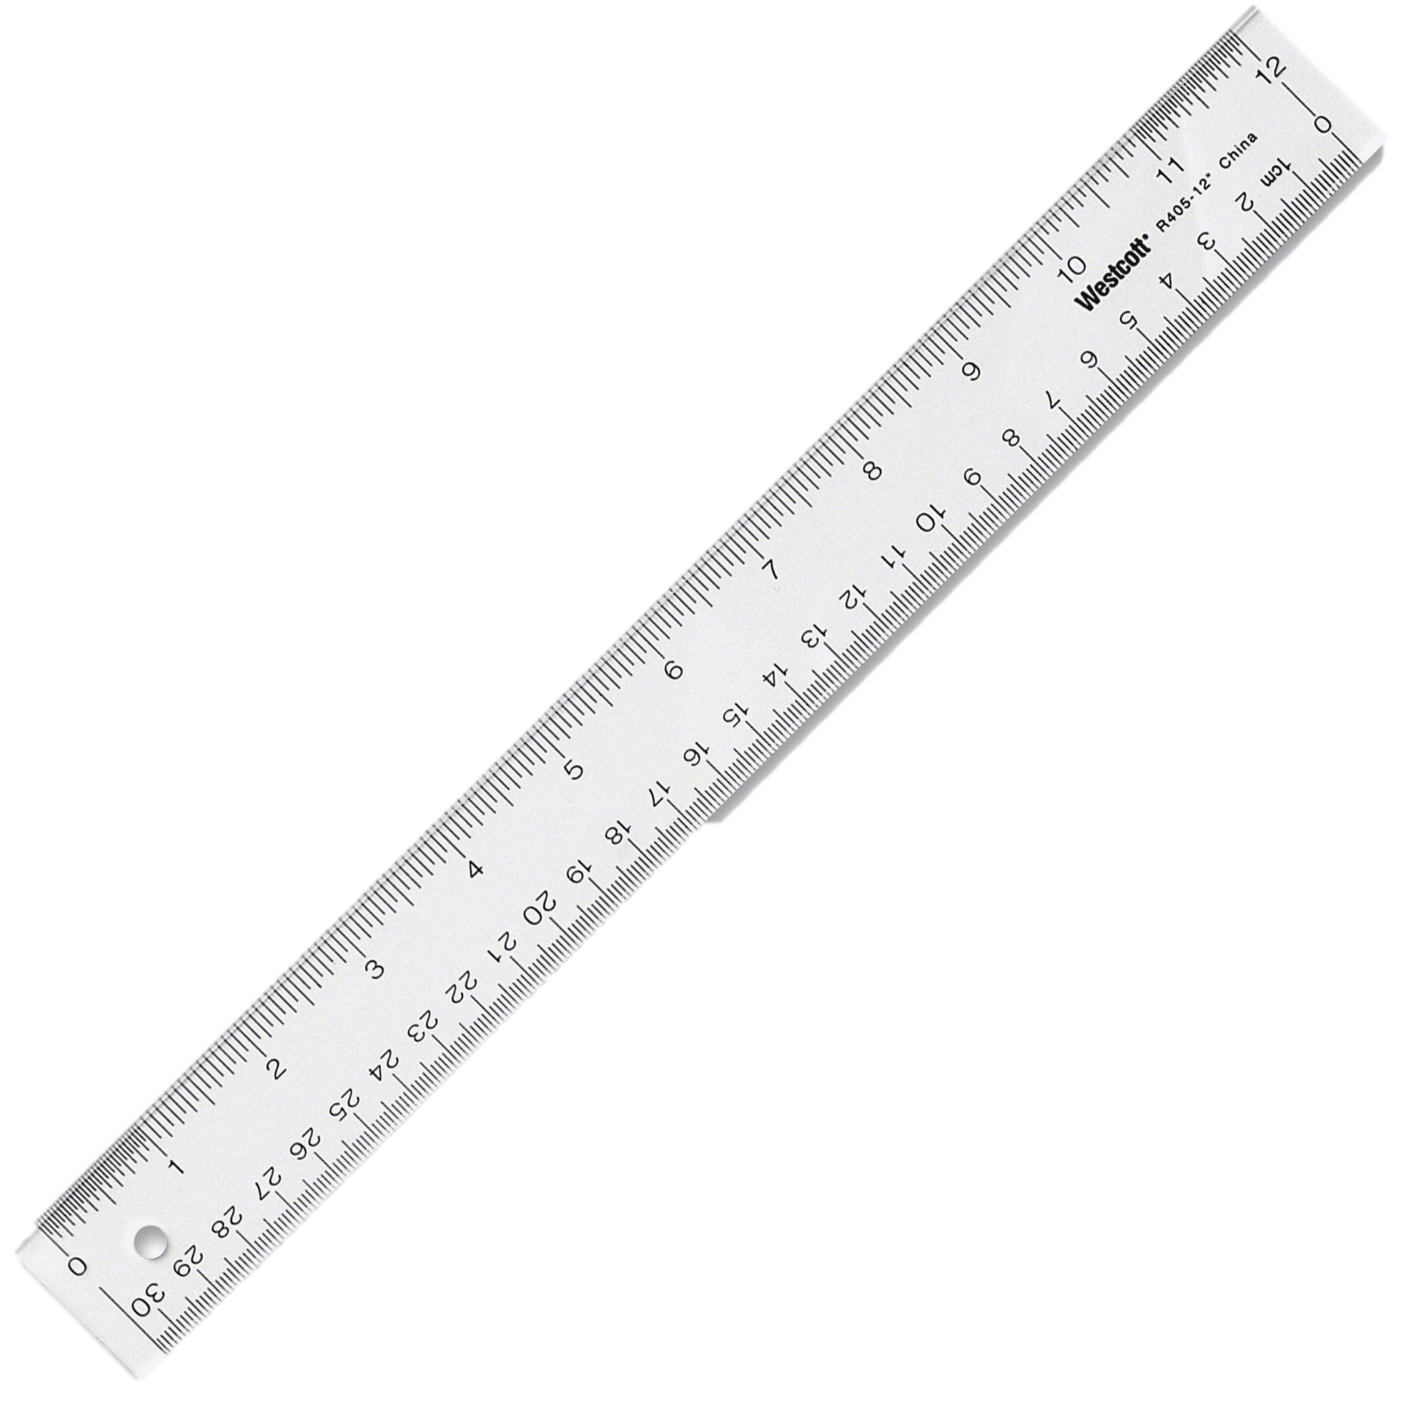
RULER
is the most popular type of measuring tool. It is usually 6 or 12 inches in length. It is needed for measuring sizes and distances.

Slide 14
What do the markings on a ruler mean?
The largest lines on a ruler represent a full inch and the distance between each large line is 1″.
The large lines on a ruler between the inch markings represent a half inch.
The lines in the middle of an inch line and a half inch line are the quarter inch lines.
The smaller lines are for an eighth of an inch. On some rulers the eighth-inch lines are the smallest lines.
The smallest lines on a ruler are the sixteenth-inch lines.

Slide 15
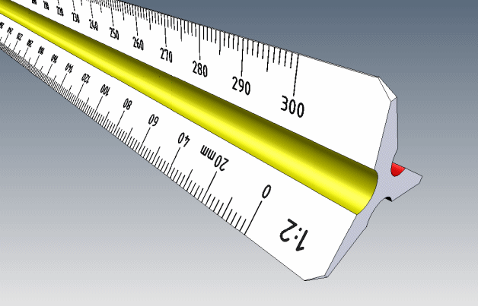
TRIANGULAR SCLAE
is used in general drawing. Its main purpose is to reproduce the dimension in full size or to reduce or enlarge them on a drawing. Scales help a drafter keep the proportions accurate.

Slide 16
Steps in using a triangular scale:
Place the edge of the scale parallel to the line being measured.
Face the edge of the scale that you're reading toward your non dominant side (if it's oriented vertically) or away from you (if it's oriented horizontally). This helps keep you from casting shadows on the relevant face of the scale as you work.
Make light marks to indicate the distance you're measuring or drawing out, as measured by the scale.

Slide 17
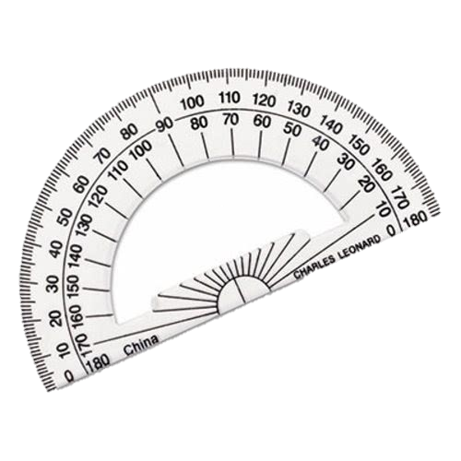
PROTRACTOR
is used for measuring and setting of angles other than those obtainable with the triangles.

Slide 18
To draw an angle with a protractor, proceed as follows:
Draw a straight line (i.e. an arm of the angle).
Place a dot at one end of the arm. This dot represents the vertex of the angle.
Place the center of the protractor at the vertex dot and the baseline of the protractor along the arm of the angle.
Find the required angle on the scale and then mark a small dot at the edge of the protractor.
Join the small dot to the vertex with a ruler to form the second arm of the angle.
Label the angle with capital letters.

Slide 19
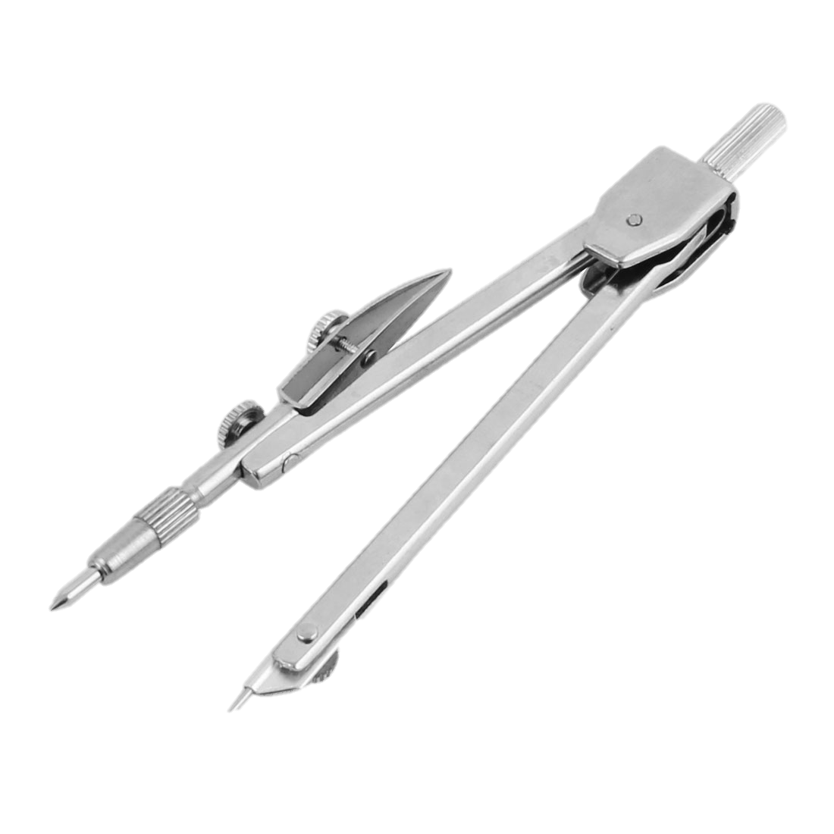
COMPASS
is used to draw circles, arcs, radii, and parts of many symbols.

Slide 20
Steps in using a compass:
Place the point of the drafting compass at the center point of the circle you intend to draw.
Adjust the leaded end of the compass so that it touches where you'd like the edge of the arc--or circle--to be.
Grasp the middle of the compass between your thumb and fingers. Twist your fingers, applying light downward pressure on the compass to mark out the desired length of arc or circle with the leaded end of the compass.

Slide 21
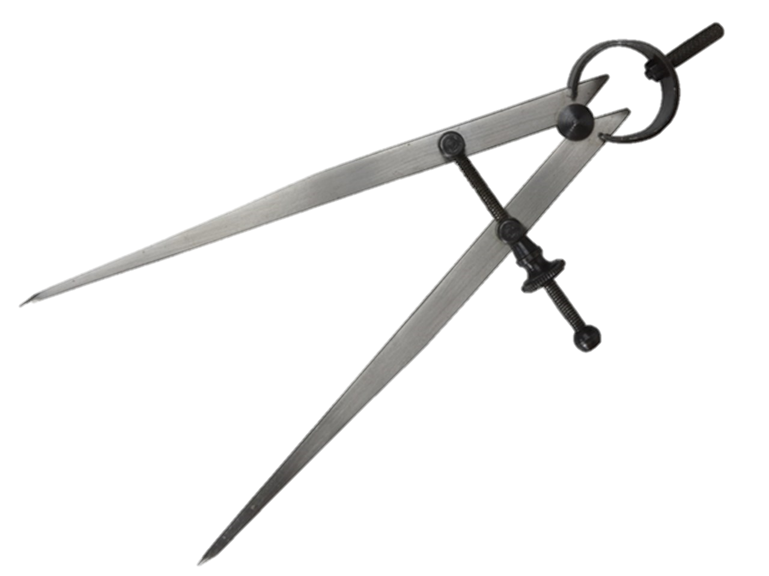
DIVIDER
is similar to the compass in construction. As the name implies, divider is used for dividing distances into a number of equal parts by the trial-and-error method.

Slide 22
Steps in using a divider:
Align each arm of the dividers so that one point is laying on the start point of the measurement you want to transfer and the other divider point is laying on the endpoint of that same measurement.
Lift the dividers off the measurement you intend to transfer, being careful not to change their alignment.
Place the dividers over the location you'd like to transfer the measurement to, and make a pencil mark to indicate where each of the dividers' pointers sits. This duplicates the measurement.

Slide 23
ACTIVITY
DRAWING AND MEASURING

Slide 24
IN FIFTEEN (15) MINUTES!
MEASURE THE FOLLOWING LINES, ANGLES, AND CIRCLES AND DRAW THEM WITH THE EXACT LENGTH AND SIZES

Slide 25
QUIZ
MATCHING TYPE

Slide 26
Match Column A with Column B. Write only the letter of the correct answer on a separate sheet of paper.
Column A | Column B
It is the measuring tool used for measuring and setting of angles | Triangle
It is the most popular type of measuring tools, usually 6 or 12 inches in length. | T-Square
Its main purpose is to reproduce, reduce or enlarge the dimension of size on a drawing. | Protractor
It is used for drawing vertical and oblique lines. | Scale
It can measure up to 48” straight lines. | Ruler
 | Divider

Slide 27
KEY TO CORRECTIONS
1. C 2. E 3. D 4. A 5. B

Slide 28
OVERALL EVALUATION
MATCHING TYPE

